Slide 1
Reminders
HW6 is due tonight by 11:59pm
HW7 has been released. It is due before Spring break

Slide 2
Grammars and Parsing
Jurafsky and Martin ChapterS 12, 13, and 14
Based on slides from Sameer Singh, Dan Jurafsky, Noah Smith, Slav Petrov, and everyone else they copied from.
Notes:
The fundamental notion underlying the idea of constituency is that of abstraction — groups of words behaving as single units, or constituents. A significant part of developing a grammar involves discovering the inventory of constituents present in the language.

Slide 3
Prescriptive v. Descriptive Grammars
Concerned with establishing norms or rules for good writing.
For example:
It’s important to never split infinitives
Prepositions are bad to end sentences with
Always have ten items or less
Describe how native speakers actually use a language.
Language is shaped by the speakers of a language and not dictated by central body.
Therefore rules should describe how language is sued.
Notes:
https://www.theguardian.com/books/2014/aug/15/steven-pinker-10-grammar-rules-break

Slide 4
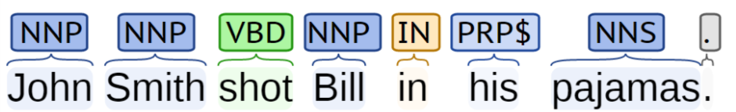
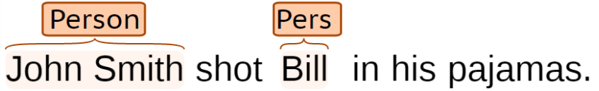
Limitations of Sequence Tags
John Smith shot Bill in his pajamas.
What happened?
Who shot who?
Who was wearing the pajamas?
Using http://nlp.stanford.edu:8080/corenlp/process
Notes:
Give an example sentence and talk about constituent and phrases

Slide 5
How do words group together in English?
A noun phrase is a sequence of words surrounding at least one noun.
What evidence do we have that these words group together?
Noun Phrases
Harry the Horse
the Broadway coppers
they
a high-class spot such as Mindy’s
the reason he comes into the Hot Box
three parties from Brooklyn
Notes:
Previously we discussed POS tagging.
Part-of-speech categories cam act as a kind of equivalence class for words.
One piece of evidence is that they can all appear in similar syntactic environments, for example, before a verb.

Slide 6
Constituents
Constituent behave as a unit that can be rearranged:
John talked [to the children] [about drugs].
John talked [about drugs] [to the children].
John talked drugs to the children about
Or substituted/expanded:
John talked [to the children taking the drugs] [about alcohol].
Harry the Horse
a high-class spot such as Mindy’s
the Broadway coppers
the reason he comes into the Hot Box
they
three parties from Brooklyn
arrive(s)
attract(s)
love(s)
sit(s)
X
“Noun phrases appear before verbs in English.”
Notes:
The fundamental notion underlying the idea of constituency is that of abstraction — groups of words behaving as single units, or constituents. A significant part of developing a grammar involves discovering the inventory of constituents present in the language.

Slide 7
Constituents and Grammars
Grammar
Tells you how the constituents can be arranged
Implicit knowledge for us (we often can’t tell why something is wrong)
Generate all, and only, the possible sentences of the language
Different from meaning:
Colorless green ideas sleep furiously.
The words are in the right order,
And that ideas are green and colorless,
And that ideas sleep,
And that sleeping is done furiously,
As opposed to: “sleep green furiously ideas colorless”

Slide 8
Uses of Parsing
[ send [the text message from James] [to Sharon] ]
[ translate [the message] [from Hindi] [to English] ]
Grammar checkers
Dialog systems
High precision question answering
Named entity recognition
Sentence compression
Extracting opinions about products
Improved interaction in computer games
Helping linguists find data
Machine translation
Relation extraction systems

Slide 9
Basic Grammar: Regular Expr.
You can capture individual words:
(men|dogs|cats)
Simple sentences:
(men|dogs|cats)(eat|love|consumed)(.|food|lunch)
Infinite length? Yes!
men (who like (cats|dogs))* cry.
S2
like
who
S3
dogs
Finite State Machine
Start
men
S1
cats
End
cry
But too weak for English.

Slide 10
Context Free Grammars

Slide 11
Context Free Grammars
Notes:
Terminal symbols (words), Non-terminal symbols (constituents), Rules, and the start symbol (sentence symbol)

Slide 12
Context-Free Grammars
Grammar, G
Terminal Symbols
Non-terminal Symbols
Rules
Grammar applies rules recursively..
If we can construct the input sentence, it is in the grammar, otherwise not.

Slide 13
Context-Free Grammars
Grammar, G
Terminal Symbols
Non-terminal Symbols
Rules
Grammar applies rules recursively..
If we can construct the input sentence, it is in the grammar, otherwise not.

Slide 14
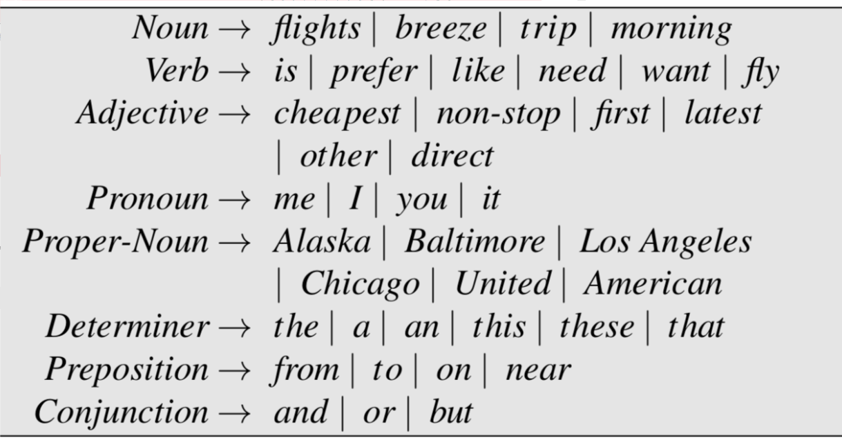
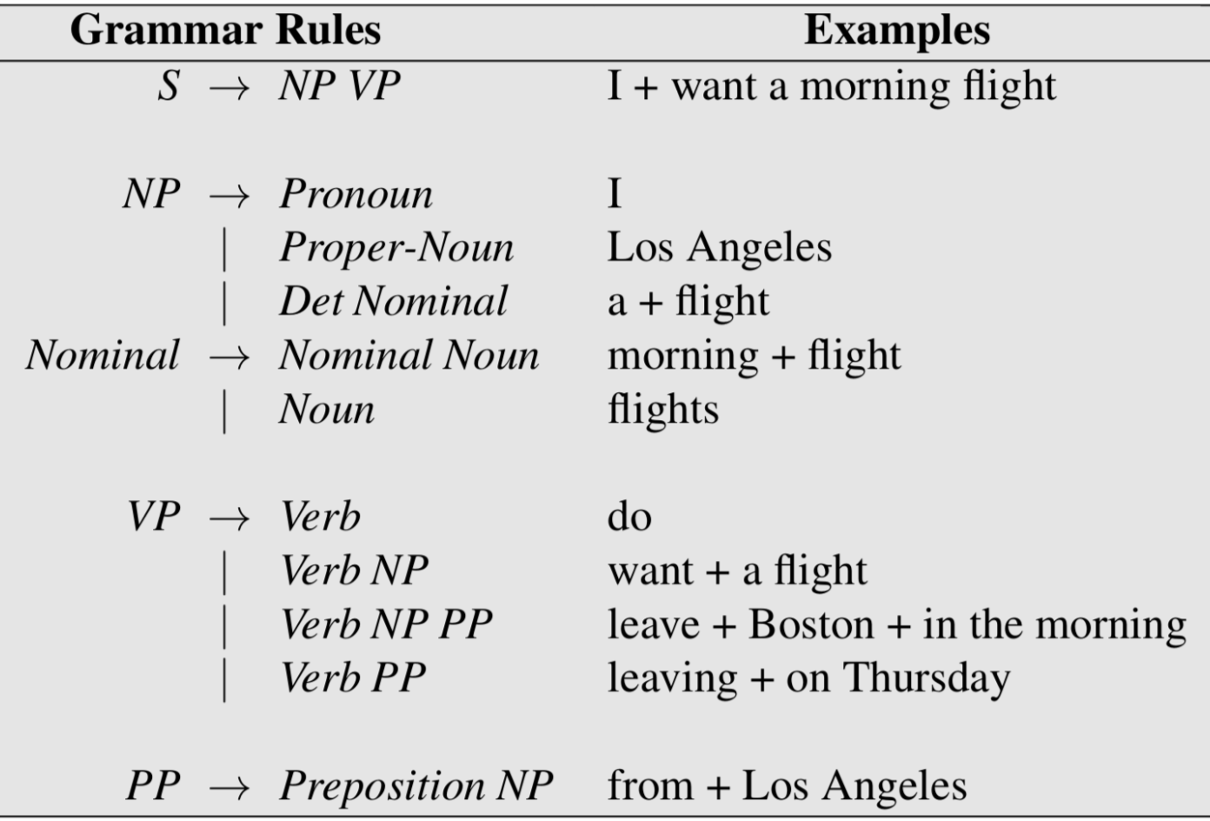
Example CFG
Notes:
To illustrate grammars, Jurafsky and Martin picked the Air Traffic Information System (ATIS) domain. ATIS systems were an early example of spoken language systems for helping book airline reservations. Users try to book flights by conversing with the system, specifying constraints like I’d like to fly from Atlanta to Denver.

Slide 15
Example CFG
Notes:
We say the string a flight can be derived from the non-terminal NP. Thus, a CFG can be used to generate a set of strings. This sequence of rule expansions is called a derivation of the string of words. It is common to represent a derivation by a parse tree

Slide 16
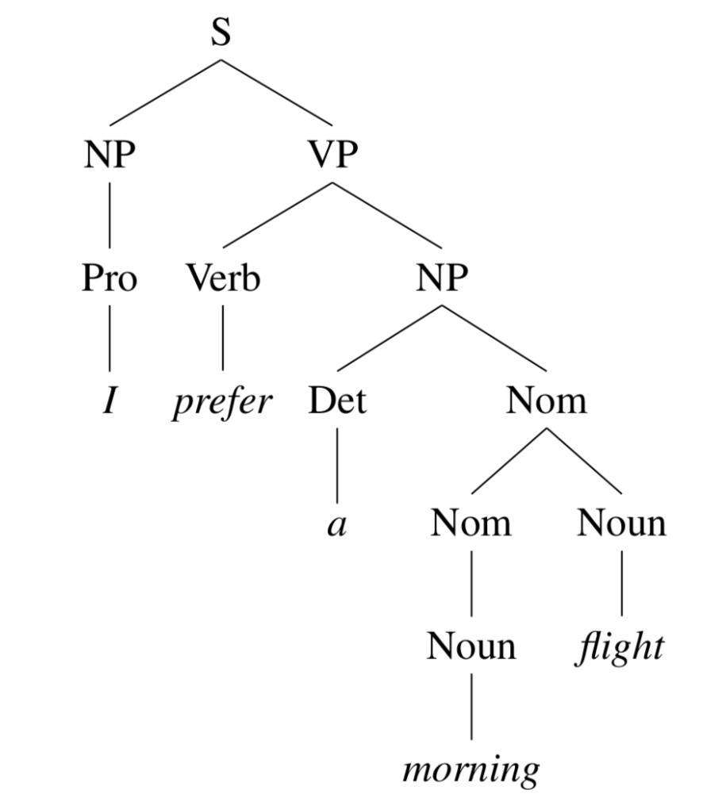
Example Parse Tree
I prefer a morning flight.
Notes:
The process of mapping from a string of words onto its parse tree is called Syntactic Parsing.

Slide 17
Example Parse Tree
I prefer a morning flight.

Slide 18
Example Parse Tree: Brackets
I prefer a morning flight.

Slide 19
Example Parse Tree: Brackets
I prefer a morning flight.

Slide 20
Types of Sentences
Declarative
S → NP VP
A plane left.
Imperative
S → VP
Show the plane.
Yes/no Questions
S → Aux NP VP
Did the plane leave?
Wh-Questions
S → WhNP Aux NP VP
When did the plane leave?
Notes:
Non-subject Wh-questions have long distance dependencies. The Wh word often belongs in a place very distant in the sentence. Compare:
Subject wh: Which plane goes to Chicgao?
Non-subject-wh question: Where does this plane go to ___?

Slide 21
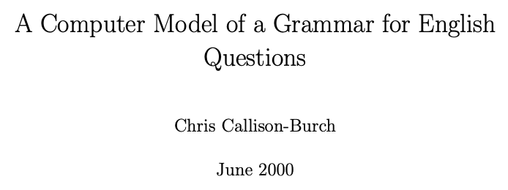

Slide 22
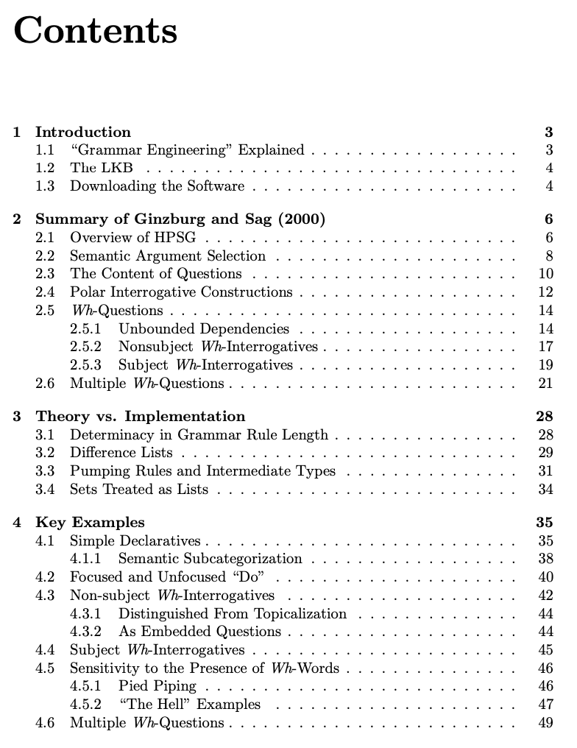
Notes:
The modifier “the hell” is sensitive to the presence of wh-words. As well. It’s perfectly mellifluous (if a bit base) to utter (61a - Figure 4.12), but is decidedly ungrammatical to say (61b).
(61) a. Who the hell left? b. *Did Kim the hell leave?

Slide 23
Clauses versus phrases
A clause expresses a “complete thought”. One example is a complete sentence, which has a main verb and all of its arguments filled.
I prefer a morning flight
Verb: Prefer
Arguments:
The subject (the holder of the preference)
The direct object (the thing preferred)

Slide 24
The Noun Phrase
Three of the most frequent types of noun phases in English are:
Pronouns
Proper nouns
The construction NP → Det Nominal
For the third type, often, we have simple determiner like:
Remember that mass nouns don’t require a determiner.
a flight | the flights | this flight
those flights | any flights | some flight
Notes:
As we saw in Chapter 8, mass nouns also don’t require determination. Recall that mass nouns often (not always) involve something that is treated like a substance (including e.g., water and snow), don’t take the indefinite article “a”, and don’t tend to pluralize. Many abstract nouns are mass nouns (music, homework). Mass nouns in the ATIS domain include breakfast, lunch, and dinner:

Slide 25
Complex determiners
Sometimes instead of single words like a, the, those, this, some, any determiners can be complex phrases themselves.
In English this can have with the possessive marker 's.
This is our first example of recursive rules.
NP → Det Nominal
Det → NP 's
CCB’s laptop
CCB’s laptop’s broken keyboard
CCB’s laptop’s keyboard’s butterfly keys

Slide 26
Nominals
NP → Det Nominal
In English, a nominal follows a determiner. This can be as simple as a single noun
Nominal → Noun
But can also be more complex with pre- or post-head noun modifiers.
Before the noun | After the head noun
Cardinal and ordinal numbers | prepositional phrases
Quantifiers (many, few, several) | non-finite clauses
Adjectives (first-class, earliest) | relative clauses
Notes:
prepositional phrases all flights from Cleveland non-finite clauses any flights arriving after eleven a.m.
relative clauses a flight that serves breakfast (relative pronouns like that or who)
Gerundive postmodifiers are so called because they consist of a verb phrase that begins with the gerundive (-ing) form of the verb. Here are some examples:
any of those [leaving on Thursday] any flights [arriving after eleven a.m.] flights [arriving within thirty minutes of each other]

Slide 27
Recursive Noun Phrases
this is the house
this is the house that Jack built
this is the cat that lives in the house that Jack built
this is the dog that chased the cat that lives in the house that Jack built
this is the flea that bit the dog that chased the cat that lives in the house the Jack built
this is the virus that infected the flea that bit the dog that chased the cat that lives in the house that Jack built

Slide 28
Recursive Noun Phrases
this is the house
this is the house that Jack built
this is the cat that lives in the house that Jack built
this is the dog that chased the cat that lives in the house that Jack built
this is the flea that bit the dog that chased the cat that lives in the house the Jack built
this is the virus that infected the flea that bit the dog that chased the cat that lives in the house that Jack built

Slide 29
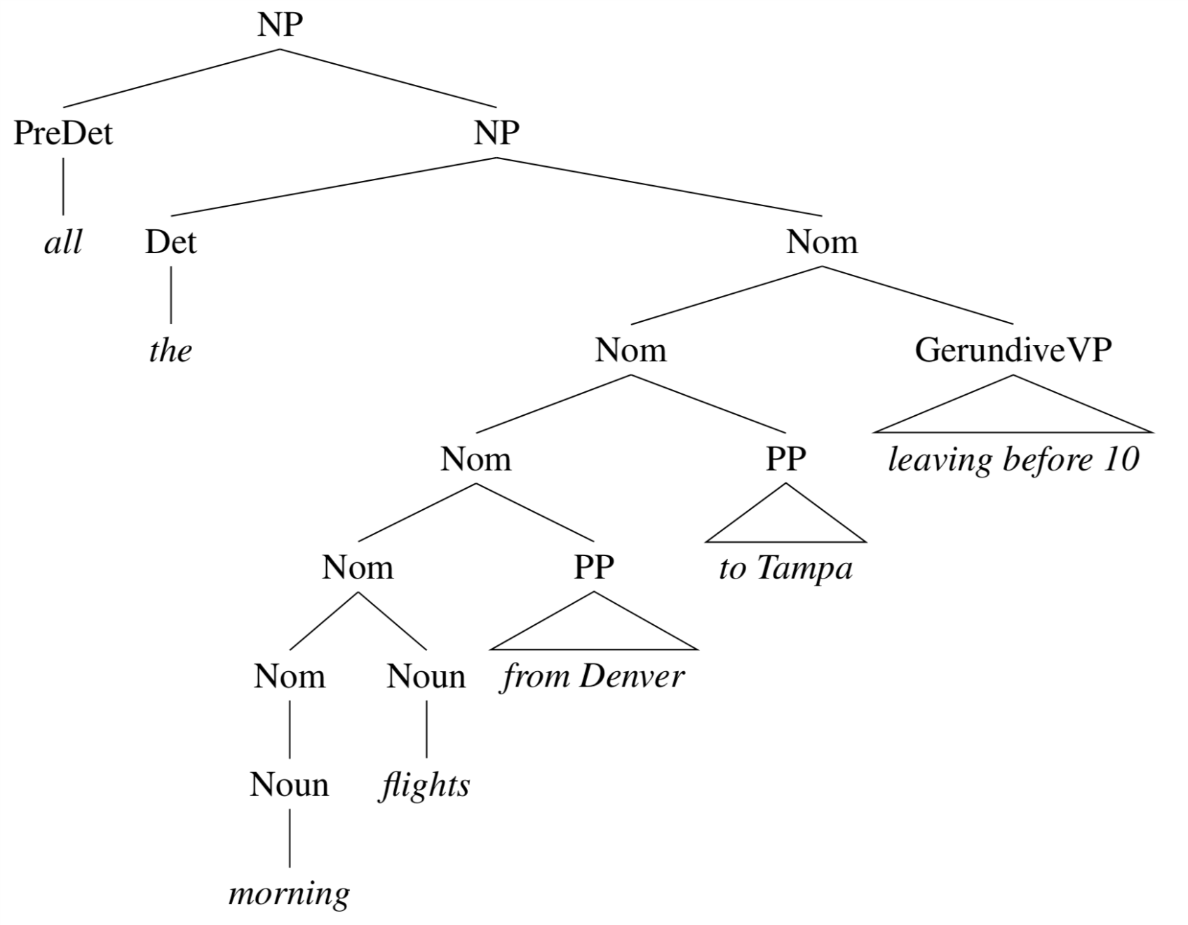
Recursive Noun Phrases
Simple Noun Phrases
NP → ProperNoun
NP → Det Nominal
Nominal → Noun | Noun Nominal
Complex Noun Phrases
“all the morning flights from Denver to Tampa leaving before 10”

Slide 30
Verb Phrases
VP → Verb disappear
VP → Verb NP prefer a morning flight
VP → Verb NP PP leave Boston in the morning
VP → Verb PP leave in the morning
Simple Verb Phrases
Sneezed: Skyler sneezed.
Read: Gaurav read the book
Find: Please find a flight to NY.
Give: Give me a cheaper fare.
Help: Can you help me with a flight?
Prefer: I prefer to leave earlier.
Told: I was told United has a flight.
But all verbs are not the same!
(this grammar over-generates)
Solution: subcategorize!

Slide 31
Subcategorization frames
Frame | Verb | Example
– | eat, sleep | I ate
NP | prefer, find, leave | Find [NP the one ring]
NP NP | show, give | Give [NP Frodo] [NP the ring]
PP_{from} PP_{to} | fly, travel | Fly [PP from Philadelphia] [PP to Honolulu]
NP PP_{with} | help | Help [NP me] [PP with my homework]
VP_{infinitival} | prefer, want, need | I would prefer [VP to finish] early
VP_{bare} | can, would, might | I can [VP finish] my homework
S | mean | Does this mean [S we are done]?
Notes:
Mention: transitive and intransitive, arguments v. adjuncts.
Where traditional grammars subcategorize verbs into these two categories (transitive and intransitive), modern grammars distinguish as many as 100 subcategories. We say that a verb like find subcategorizes for an NP, and a verb like want sub- categorizes for either an NP or a non-finite VP. We also call these constituents the complements of the verb (hence our use of the term sentential complement above). So we say that want can take a VP complement. These possible sets of complements are called the subcategorization frame for the verb. Another way of talking about the relation between the verb and these other constituents is to think of the verb as a logical predicate and the constituents as logical arguments of the predicate.

Slide 32
Expanding our rule set
We could create subtypes of the class Verb capture the association between verbs and their complements:
Verb-with-NP-complement → find| leave| repeat| ...
Verb-with-S-complement → think| believe| say| ...
Verb-with-Inf-VP-complement → want| try| need| ...
Then modify each VP rule to give the right argument types:
VP → Verb-with-no-complement
VP → Verb-with-NP-comp NP
VP → Verb-with-S-comp S
Notes:
A problem with this approach is the significant increase in the number of rules and the associated loss of generality.

Slide 33
Predicate-argument relations
Another way of talking about the relation between the verb and these other constituents is to think of the verb as a logical predicate and the constituents as logical arguments of the predicate.
FIND(BILBO, THE RING)
WANTS(SAURON, THE RING)
THROW(FRODO, THE RING, MOUNT DOOM)

Slide 34
Coordination
Conjunctions like and, or, and but can form larger constructions of the same type. For example, a coordinate noun phrase can consist of two other noun phrases separated by a conjunction:
Please repeat [NP [NP the flights] and [NP the costs]]
I need to know [NP [NP the aircraft] and [NP the flight number]]
Here’s a rule that allows these structures:
NP → NP and NP
This also works with other types, like VP, S and Nominal. So some people create “Metarules” like
X → X and X

Slide 35
Source of Grammar?
Manual
Write symbolic grammar (CFG or often richer) and lexicon
S → NP VP NN → interest
NP → (DT) NN NNS → rates
NP → NN NNS NNS → raises
NP → NNP VBP → interest
VP → V NP VBZ → rates
Used grammar/proof systems to prove parses from words
Fed raises interest rates 0.5% in effort to control inflation
Minimal grammar: 36 parses
Simple 10 rule grammar: 592 parses
Real-size broad-coverage grammar: millions of parses
Noam Chomsky

Slide 36
Source of Grammar?
From data!
The Penn Treebank
Building a treebank seems a lot slower and less useful than building a grammar
But a treebank gives us many things
Reusability of the labor
Many parsers, POS taggers, etc.
Valuable resource for linguistics
Broad coverage
Frequencies and distributional information
A way to evaluate systems
[Marcus et al. 1993, Computational Linguistics]

Slide 39
( (S
(NP-SBJ (DT The) (NN move))
(VP (VBD followed)
(NP
(NP (DT a) (NN round))
(PP (IN of)
(NP
(NP (JJ similar) (NNS increases))
(PP (IN by)
(NP (JJ other) (NNS lenders)))
(PP (IN against)
(NP (NNP Arizona) (JJ real) (NN estate) (NNS loans))))))
(, ,)
(S-ADV
(NP-SBJ (-NONE- *))
(VP (VBG reflecting)
(NP
(NP (DT a) (VBG continuing) (NN decline))
(PP-LOC (IN in)
(NP (DT that) (NN market)))))))
(. .)))

Slide 40
Some of the rules, with counts
40717 PP → IN NP
33803 S → NP-SBJ VP
22513 NP-SBJ → -NONE-
21877 NP → NP PP
20740 NP → DT NN
14153 S → NP-SBJ VP .
12922 VP → TO VP
11881 PP-LOC → IN NP
11467 NP-SBJ → PRP
11378 NP → -NONE-
11291 NP → NN
...
989 VP → VBG S
985 NP-SBJ → NN
983 PP-MNR → IN NP
983 NP-SBJ → DT
969 VP → VBN VP
100 VP → VBD PP-PRD
100 PRN → : NP :
100 NP → DT JJS
100 NP-CLR → NN
99 NP-SBJ-1 → DT NNP
98 VP → VBN NP PP-DIR
98 VP → VBD PP-TMP
98 PP-TMP → VBG NP
97 VP → VBD ADVP-TMP VP
...
10 WHNP-1 → WRB JJ
10 VP → VP CC VP PP-TMP
10 VP → VP CC VP ADVP-MNR
10 VP → VBZ S , SBAR-ADV
10 VP → VBZ S ADVP-TMP
4500 rules
for VP!
Notes:
The sentences in a treebank implicitly constitute a grammar of the language represented by the corpus being annotated. we can extract each of the CFG rules in from each sentence.

Slide 41
NP rules
NP → DT JJ NN NP → DT JJ NNS NP → DT JJ NN NN NP → DT JJ JJ NN NP → DT JJ CD NNS NP → RB DT JJ NN NN NP → RB DT JJ JJ NNS NP → DT JJ JJ NNP NNS NP → DT NNP NNP NNP NNP JJ NN NP → DT JJ NNP CC JJ JJ NN NNS NP → RB DT JJS NN NN SBAR NP → DT VBG JJ NNP NNP CC NNP NP → DT JJ NNS , NNS CC NN NNS NN NP → DT JJ JJ VBG NN NNP NNP FW NNP NP → NP JJ , JJ ‘‘ SBAR ’’ NNS
[DT The] [JJ state-owned] [JJ industrial] [VBG holding] [NN company] [NNP Instituto] [NNP Nacional] [FW de] [NNP Industria]
[NP Shearson’s] [JJ easy-to-film], [JJ black-and-white] “[SBAR Where We Stand]” [NNS commercials]

Slide 42
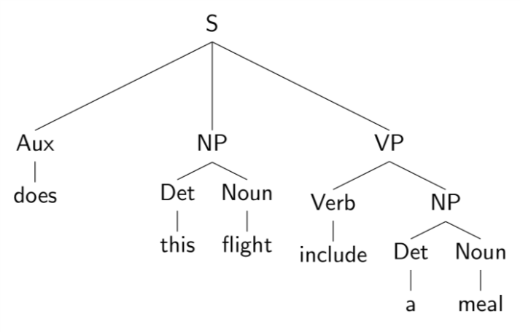
Evaluating Parses
Each parse tree is represented by a list of tuples:
Use this to estimate precision/recall!

Slide 43
Evaluating Parses
Each parse tree is represented by a list of tuples:
Use this to estimate precision/recall!

Slide 44
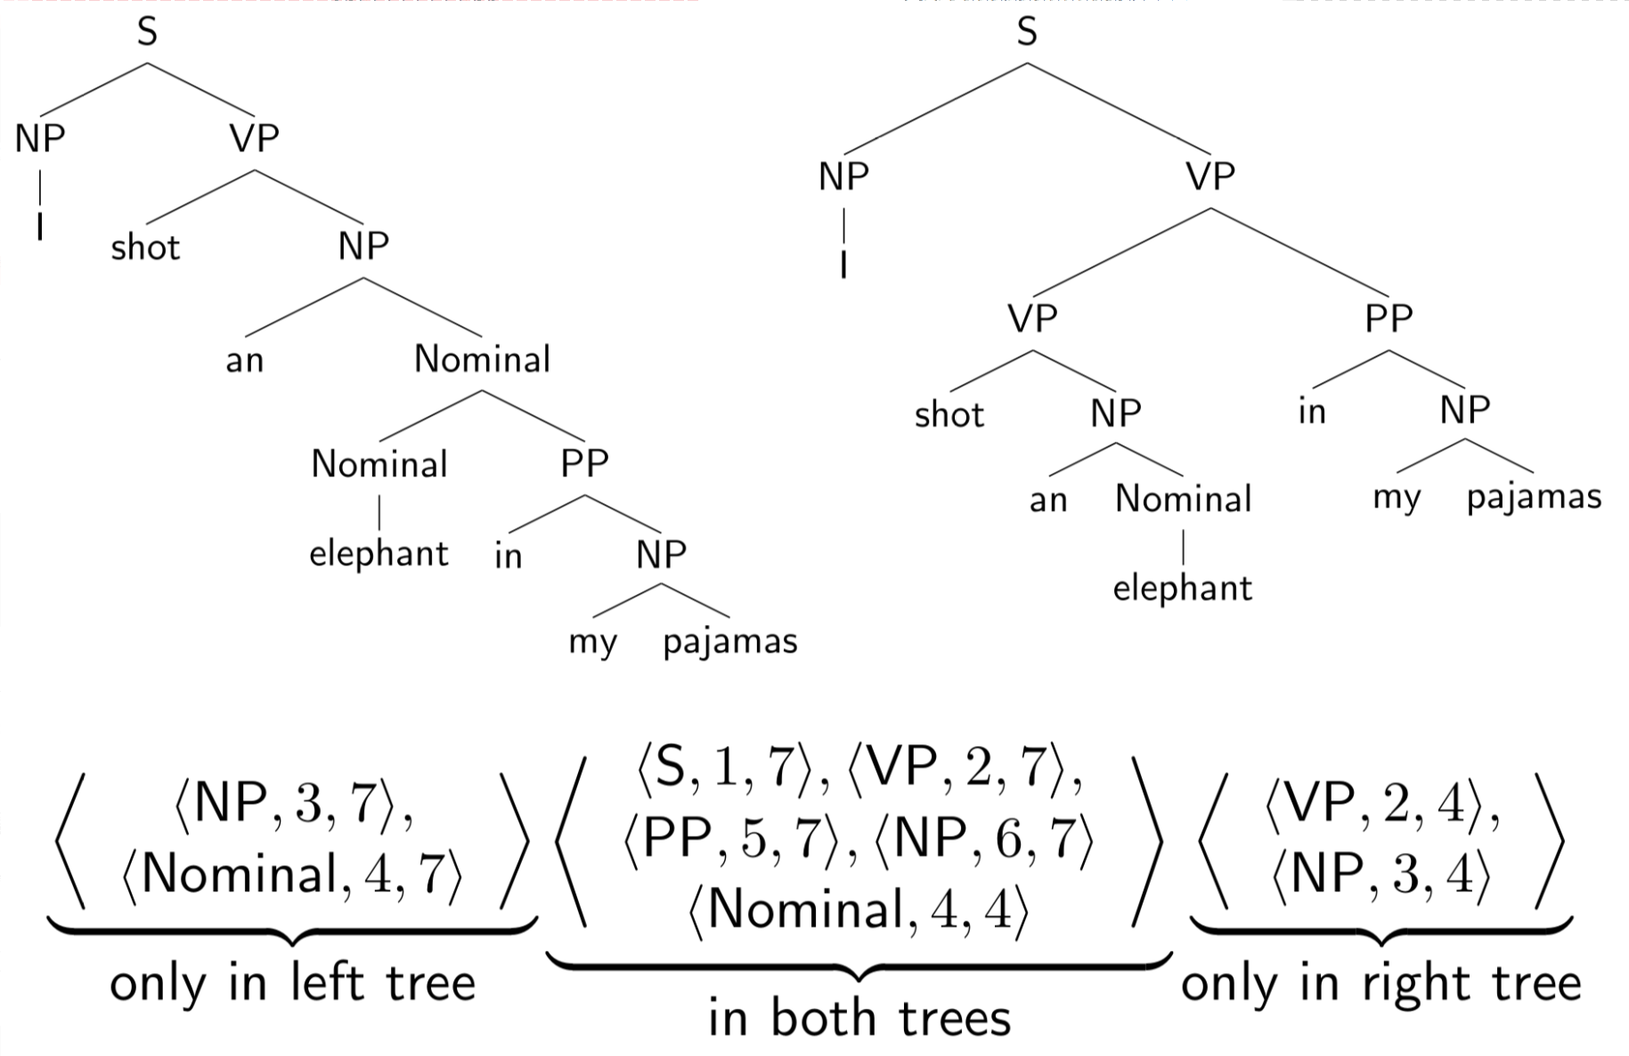
Evaluating Parses: Example

Slide 45
Evaluating Parses: Example

Slide 46
Outline
Context Free Grammars
Parsing: CKY Algorithm
Extensions: Probabilistic and Lexicalized
Dependency Parsing

Slide 47
The Parsing Problem
Given sentence x and grammar G,
Recognition
Is sentence x in the grammar? If so, prove it.
“Proof” is a deduction, valid parse tree.
Parsing
Show one or more derivations for x in G.
Even with small grammars, brute force grows exponentially!
“Book that flight”

Slide 48
Left to Right?
The old man the boat.
The complex houses married and single soldiers and their families.
Garden Path Sentences

Slide 49
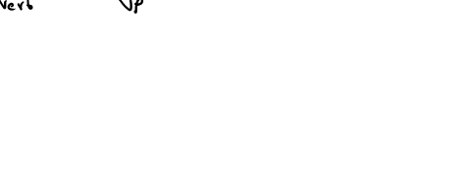
Left to Right?
The old man the boat.
The complex houses married and single soldiers and their families.
Garden Path Sentences

Slide 50
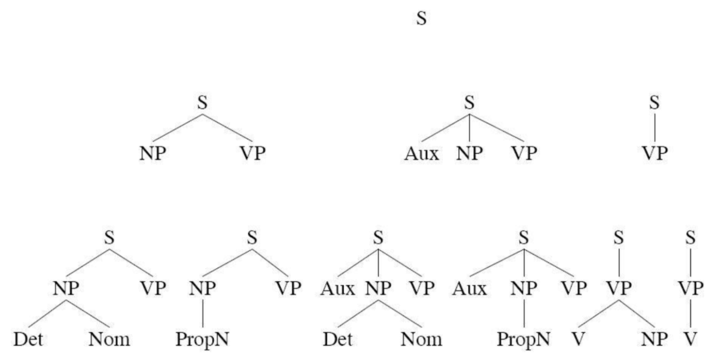
Top Down Parsing
“Book that flight”
Considers only valid trees
But are inconsistent with the words!

Slide 51
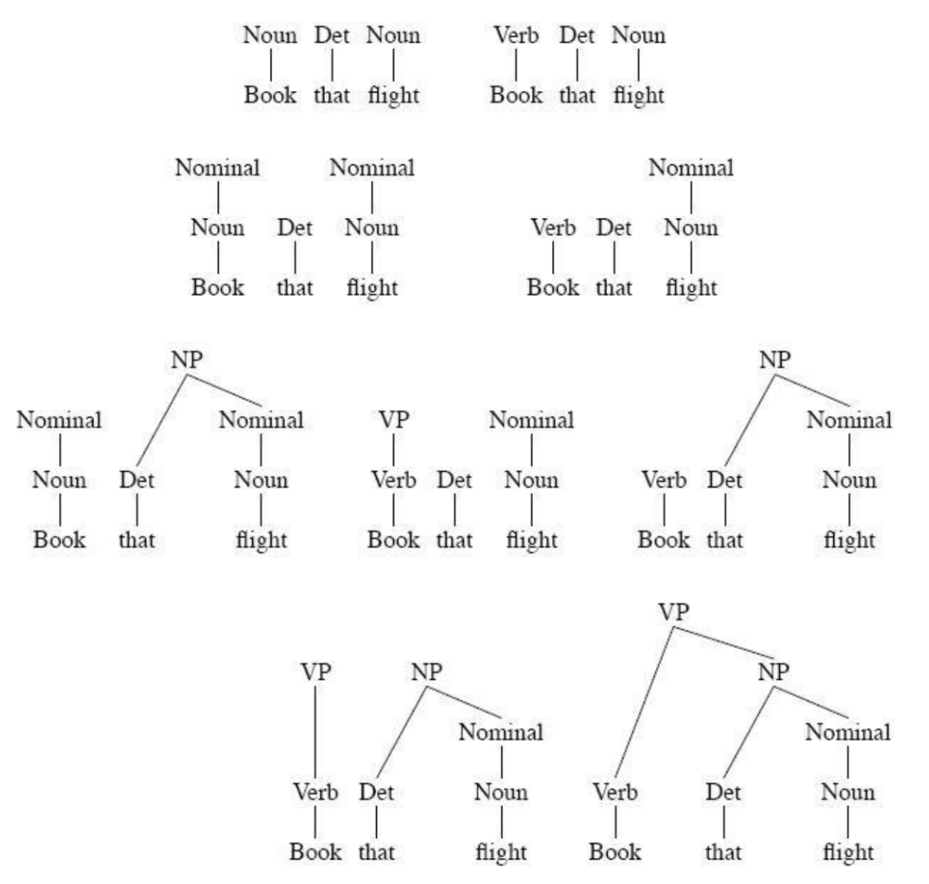
Bottom-up Parsing
“Book that flight”
Builds only consistent trees
But most of them are invalid (don’t go anywhere)!

Slide 52
Chomsky Normal Form
Context free grammar where all non-terminals to go:
2 non-terminals, or
A single terminal
A → B C
D → w
Converting to CNF
Case 1
Case 2
A → B
B → C D
B → w
A → C D
A → w
A → X E
X → Y D
Y → B C
A → B C D E

Slide 53
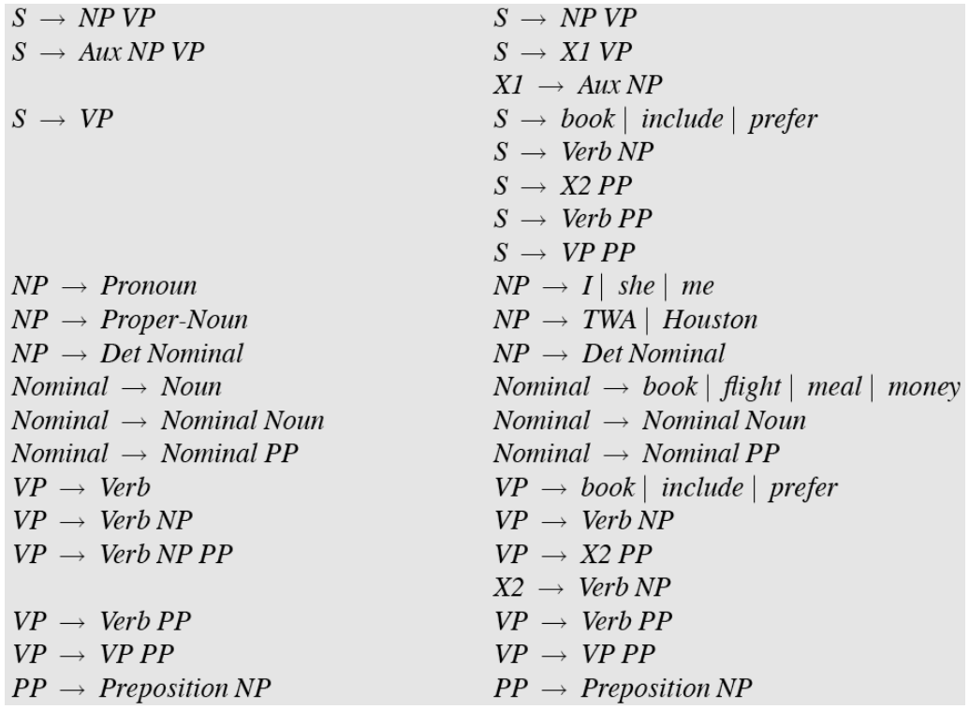
Original Grammar
Chomsky Normal Form

Slide 54
Dynamic Programming
table[i,j] = Set of all valid non-terminals for the constituent span (i,j)
A
(j-1,j)
Rule: A → word[j]
Base case
A should be in table[j-1,j]
word[j]
Recursion
Rule: A → B C
(i,j)
A
If you find a k such that
B is in table[i,k], and
C is in table[k,j], then A should be in table[i,j]
C
B
(i,k)
(k,j)

Slide 55
Dynamic Programming
table[i,j] = Set of all valid non-terminals for the constituent span (i,j)
A
(j-1,j)
Rule: A → word[j]
Base case
A should be in table[j-1,j]
word[j]
Recursion
Rule: A → B C
(i,j)
A
If you find a k such that
B is in table[i,k], and
C is in table[k,j], then A should be in table[i,j]
C
B
(i,k)
(k,j)

Slide 56
CKY Algorithm
Book
the
flight
through
TWA
Notes:
01, S VP Verb Nom Noun; 12, Det; 23 Nom N; 3,4 Prep; 4,5 NP, Proper
13 NP; 35 PP;
03, S, VP, X2; 25, Nom
15 NP
05 X2, VP, VP, S(01,15), S(03,35,X2 PP), S(03,35,VP PP)

Slide 57
CKY Algorithm
Book
the
flight
through
TWA
Notes:
01, S VP Verb Nom Noun; 12, Det; 23 Nom N; 3,4 Prep; 4,5 NP, Proper
13 NP; 35 PP;
03, S, VP, X2; 25, Nom
15 NP
05 X2, VP, VP, S(01,15), S(03,35,X2 PP), S(03,35,VP PP)

Slide 58
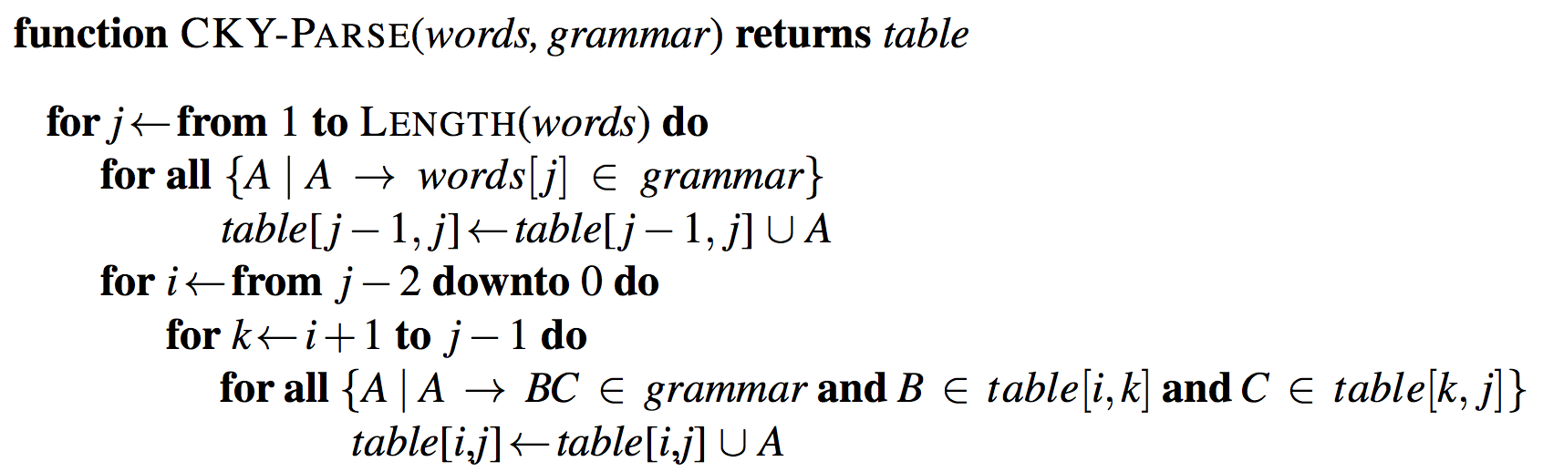
CKY Algorithm

Slide 59
CKY Algorithm

Slide 60
CKY Algorithm: Complexity
|N|: Number of non-terminals
|R|: Number of rules
n: Number of tokens in the sentence
Memory
Time
Notes:
Nn^2 and Rn^3

Slide 61
CKY Algorithm: Complexity
|N|: Number of non-terminals
|R|: Number of rules
n: Number of tokens in the sentence
Memory
Time
Notes:
Nn^2 and Rn^3

Slide 62
Outline
Parsing: CKY Algorithm
Extensions: Probabilistic and Lexicalized
Dependency Parsing

Slide 63
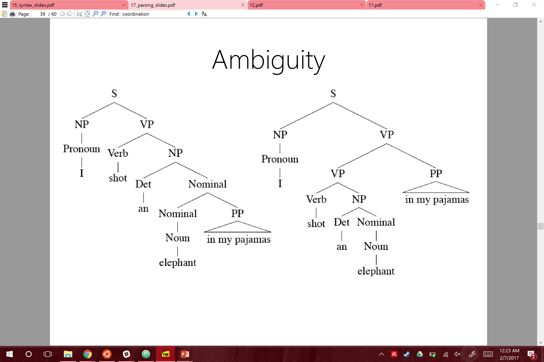
Ambiguity: Which parse?
I shot an elephant in my pajamas.

Slide 64
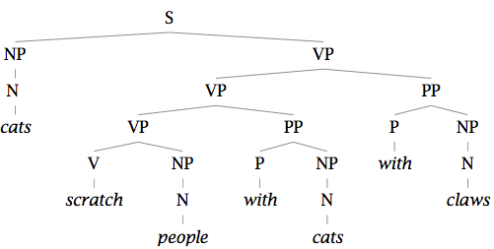
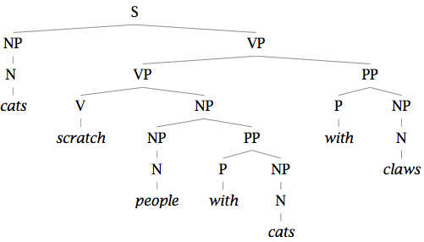
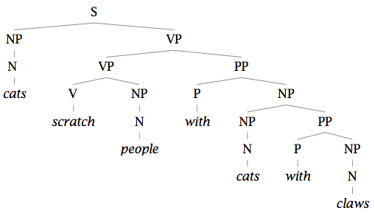
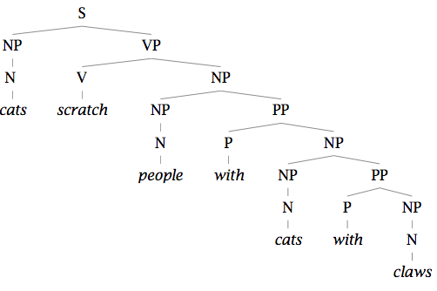
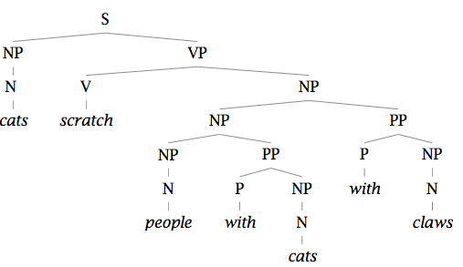
Finding the Best Parse Tree
Cats scratch people with cats with claws.

Slide 65
Finding the Best Parse Tree
Cats scratch people with cats with claws.

Slide 66
Probabilistic CFGs
Same as a regular context-free grammar:
Terminal, non-terminals, and rules
Additionally, attach a probability to each rule!
Rule: A → B C
Probability: P(A → B C | A)
Compute the probability of a parse tree:

Slide 67
Probabilistic CFGs
Same as a regular context-free grammar:
Terminal, non-terminals, and rules
Additionally, attach a probability to each rule!
Rule: A → B C
Probability: P(A → B C | A)
Compute the probability of a parse tree:

Slide 68
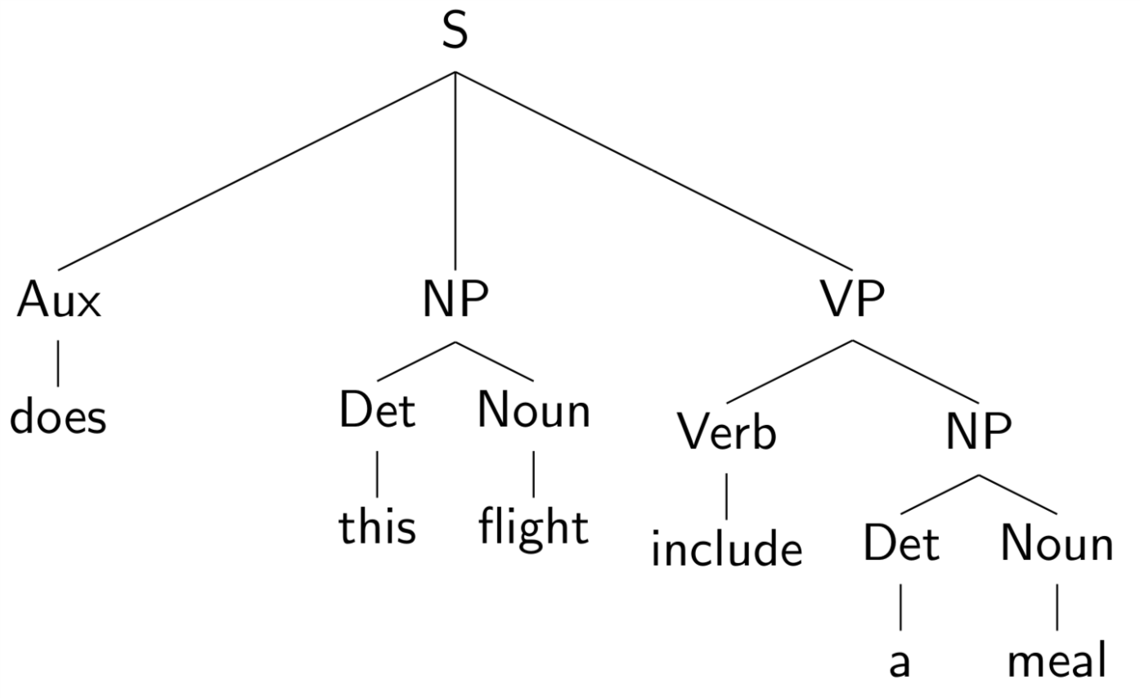
Example of a PCFG

Slide 69
Example of a PCFG

Slide 70
Estimating the probabilities

Slide 71
Estimating the probabilities

Slide 72
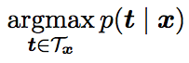
The Parsing Problem
Given sentence x and grammar G,
Recognition
Is sentence x in the grammar? If so, prove it.
“Proof” is a deduction, valid parse tree.
Parsing
Show one or more derivations for x in G.
Even with small grammars, grows exponentially!

Slide 73
Probabilistic CKY Algorithm
T[i,j,A] = Probability of the best parse with root A for the span (i,j)
A
(j-1,j)
Rule: P( A → word[j] )
Base case
T[j-1,j,A] = P(word[j] | A)
word[j]
Recursion
Rule: P( A → B C )
(i,j)
A
Try every position k, and every non-terminal pair:
B
C
T[i,j,A] = max P(B C| A) T[i,k,B] T[k,j,C]
(i,k)
(k,j)

Slide 74
Lexicalized PCFGs

Slide 75
Lexicalized PCFGs

Slide 76
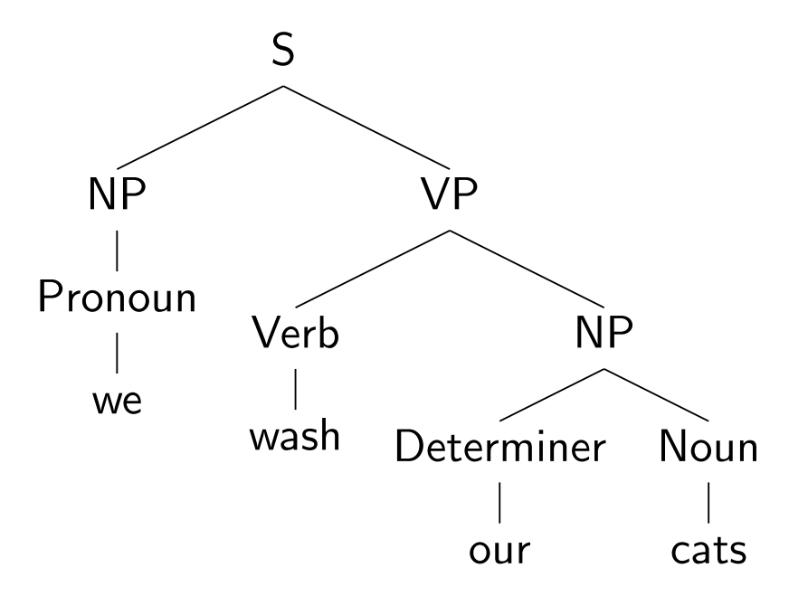
Lexicalizing a CFG

Slide 77
Lexicalizing a CFG

Slide 78
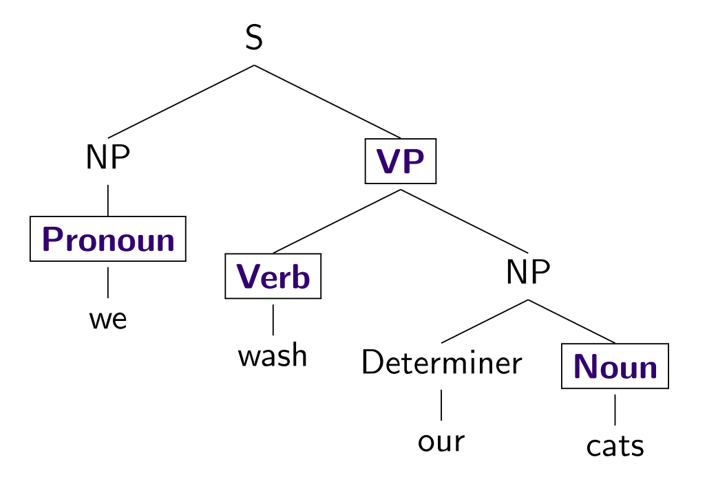
Lexicalizing a CFG

Slide 79
Lexicalizing a CFG

Slide 80
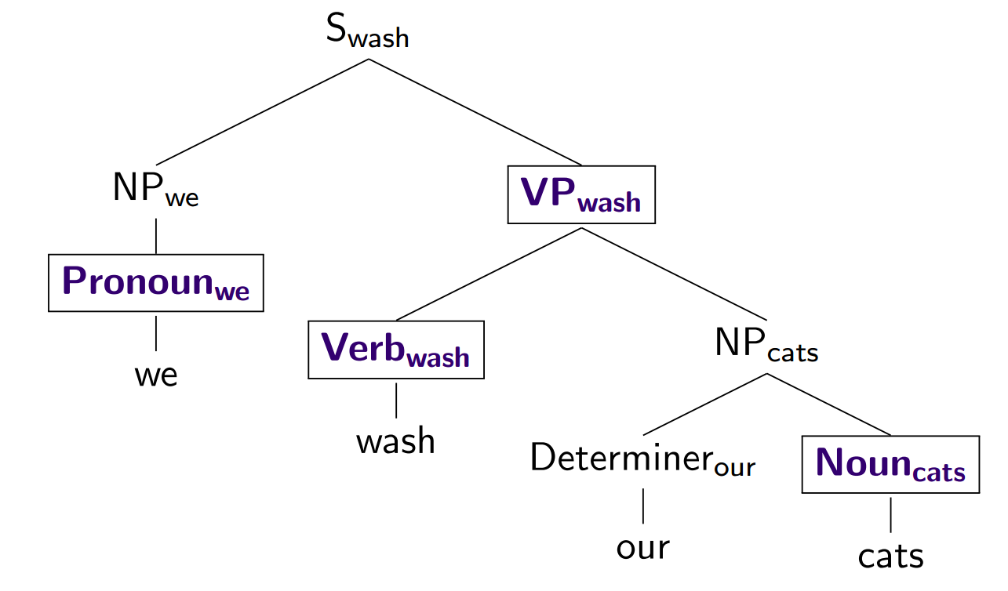
Lexicalizing a CFG

Slide 81
Outline
Parsing: CKY Algorithm
Extensions: Probabilistic and Lexicalized
Dependency Parsing

Slide 82
Dependencies
Represent only the syntactic dependencies…

Slide 83
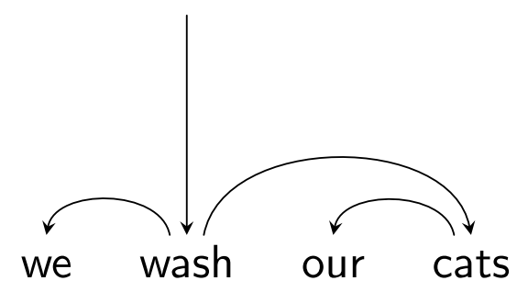
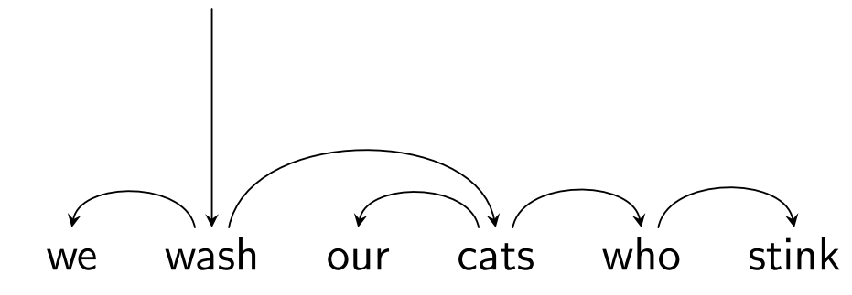
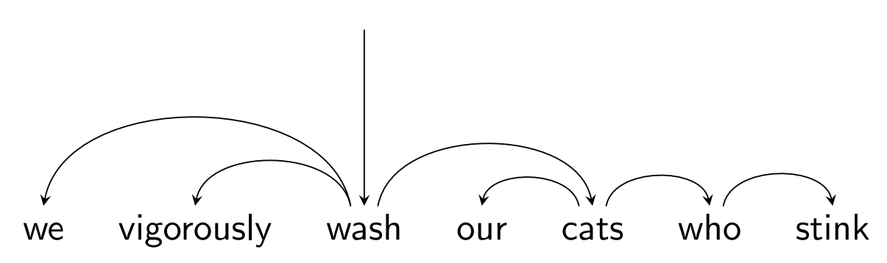
Nested Structure = Subtrees

Slide 84
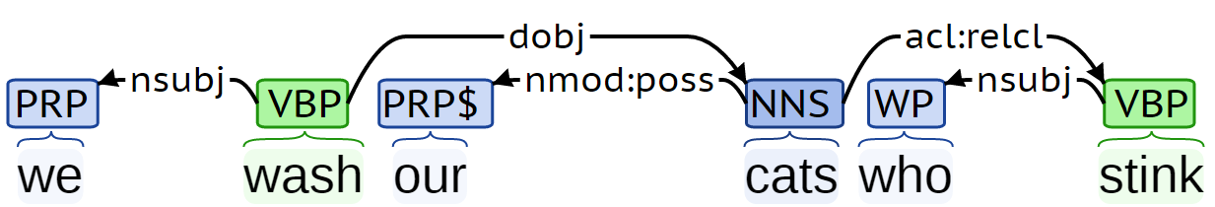
Dependency Labels

Slide 85
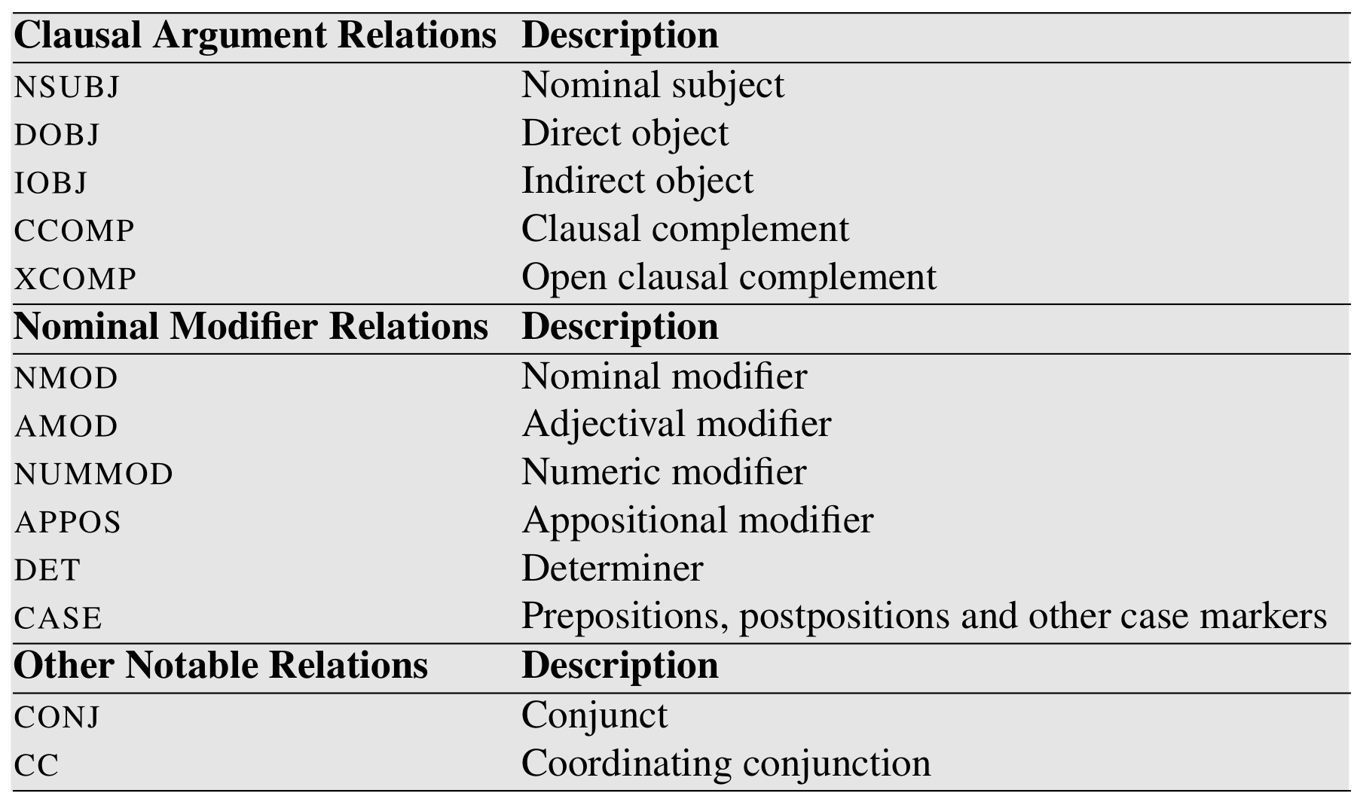
Dependency Labels

Slide 86
Dependency Trees
Notes:
Parent/head/governor, child/dependent/modifier, label/relation/type
Connected, acyclic, single-head, projective

Slide 87
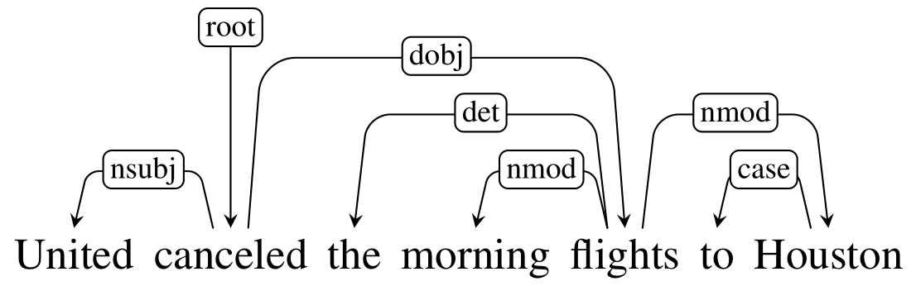
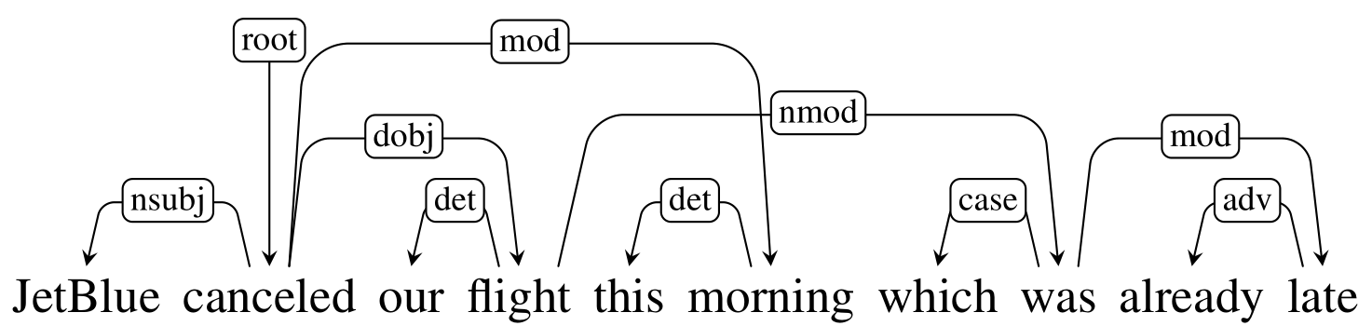
Projective vs Non-projective

Slide 88
Evaluating Dependency Parses
ROOT She saw the video lecture
0 1 2 3 4 5
ROOT She saw the video lecture
0 1 2 3 4 5
Gold
2 She nsubj
0 saw root
5 the det
5 video nn
2 lecture dobj
Parsed
2 She nsubj
0 saw root
4 the det
5 video nsubj
2 lecture ccomp
Notes:
Labeled attachment score, unlabeled attachment score

Slide 89
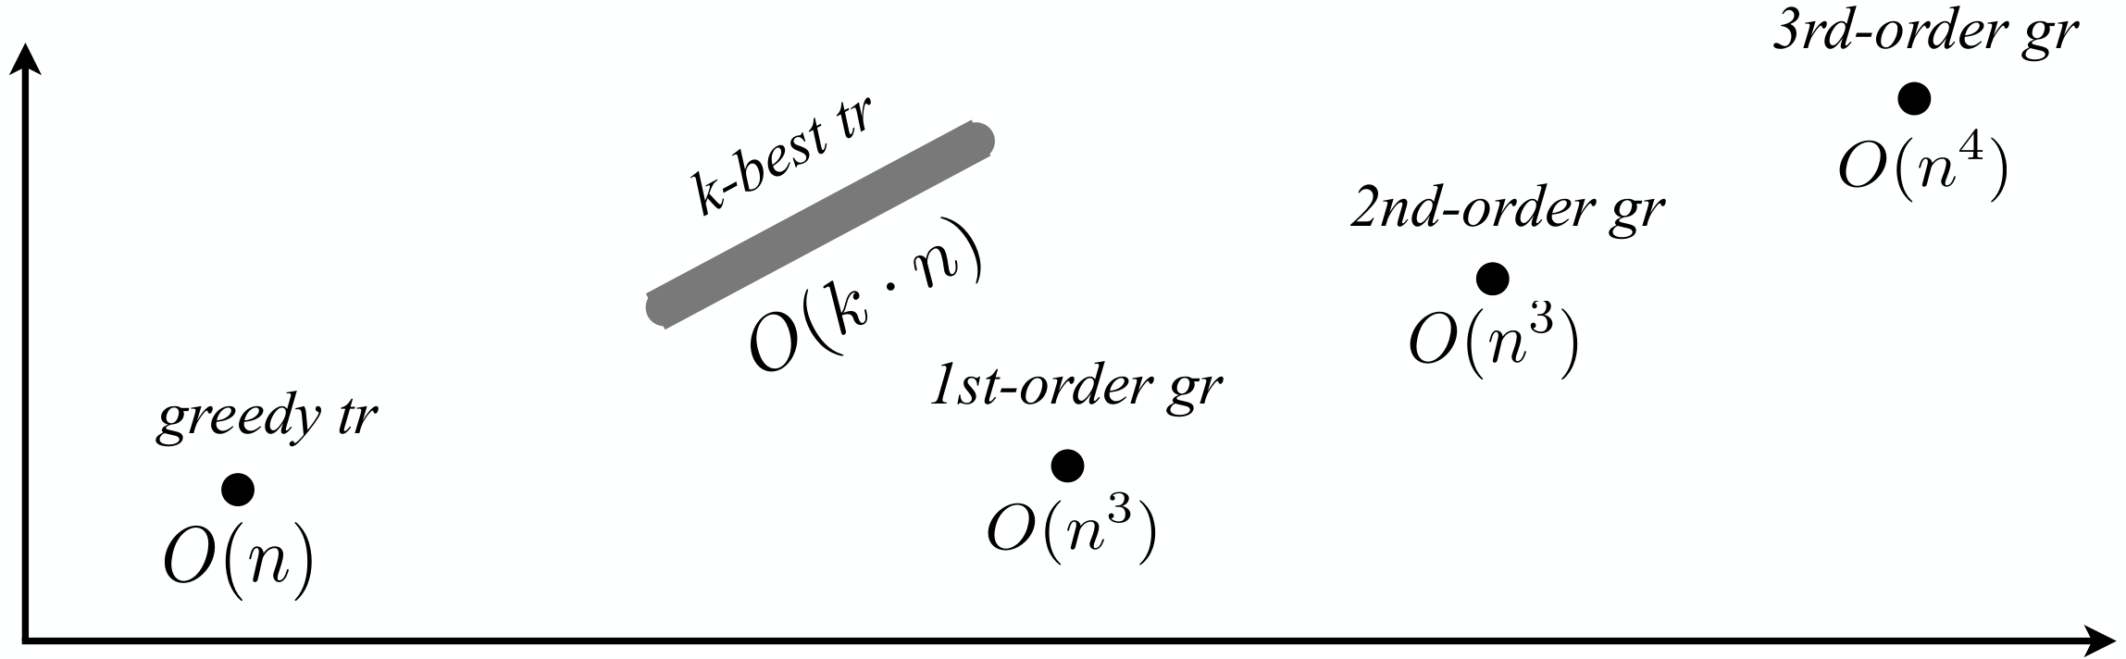
Parsing Algorithms
Transition-based
Graph-based
Fast, greedy, linear-time
Trained for greedy search
Features decide what to do next
Beam search, i.e. k-best
Slower, exhaustive algorithms
Dynamic programming, inference
Features used to score whole trees
Accuracy
Running time

Slide 90
Graph-based Parsing
Notes:
Arc-factored (1st order), 2nd order, 3rd order, and so on
Dynamic Programming for projective, MST for non-projective

Slide 91
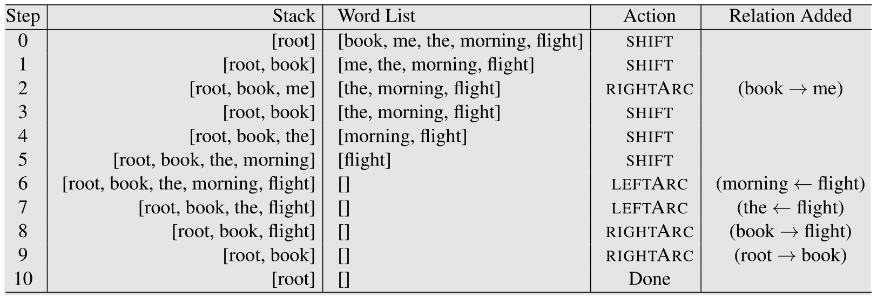
Transition-based Parsing

Slide 92
Transition-based Parsing

Slide 93
Transition-based Parsing

Slide 94
Transition-based Parsing

Slide 95
Transition-based Parsing

Slide 96
Transition-based Parsing

